Slide 1

Lesson 3:
Computing Scheme of Work
Unit 2.4 – Questioning
Binary Trees
Notes:
RESOURCES
For this lesson, and following lessons, there are two possible topics for the data: Continuing to use the avatars data or using data about animals.
‘yes’ and ‘no’ arrows. You will need several copies to construct a paper binary tree on either the floor or the wall (depending on your classroom layout).
Whiteboard/paper.
Large avatar pictures from the last lesson or large animal pictures.
Avatar Binary Tree images or Animal Binary Tree Images. Print one copy per child/pair.
Binary Tree Outline. These will need to be enlarged to A3 size and printed for each child/pair.
Glue, scissors and Blu-Tack.

Slide 2


Aims
Slide 2
To construct a binary tree to separate different items.
Need more support? Contact us:
Tel: +44(0)208 203 1781 | Email: support@2simple.com | Twitter: @2simplesoftware
Notes:
Display slide 2 and outline the lesson aim.

Slide 3
Success Criteria
Slide 3
Children understand what is meant by a binary tree.
Children have designed a binary tree to sort pictures of children or animals.
Need more support? Contact us:
Tel: +44(0)208 203 1781 | Email: support@2simple.com | Twitter: @2simplesoftware
Notes:
Display slide 3 and outline the success criteria.
Recap the learning from the last lesson. For this lesson you need to decide if you are going to use the avatars or animal pictures.

Slide 4
How to Sort the Objects on a Binary Tree
Slide 4
Choose if the class want to use the avatar pictures or animal pictures.
Think of a question to split the pictures into two groups. It must be a ‘YES’ or ‘NO’ question.
Choose one group and think of what question could be used to split this group into a smaller group?
Repeat this until all the images have been placed on the binary tree.
Need more support? Contact us:
Tel: +44(0)208 203 1781 | Email: support@2simple.com | Twitter: @2simplesoftware
Notes:
Display slide 4. Explain to the children that the class will be creating a binary tree. Since binary trees are used for identification of unknown items, the questions must be something observable rather than requiring knowledge of the item e.g. ‘Does it have legs?’ rather than, ‘Is it a herbivore?’
Splitting into equal halves will result in the fewest (average) number of steps to the solution for all the items.
Write the question onto paper/whiteboard and then put ‘yes’/’no’ arrows on the floor or Blu-Tack them to the board. It is advisable to enlarge the arrows onto A3 paper.
Repeat until all the items are sorted individually.
Select one item and check that the binary tree works and leads to the correct item.

Slide 5
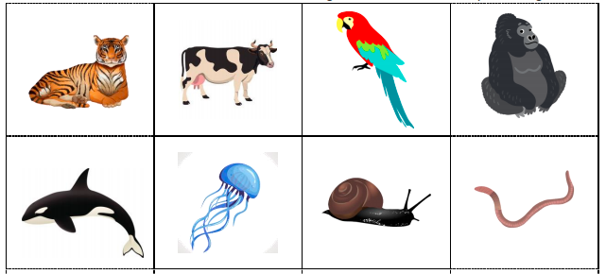
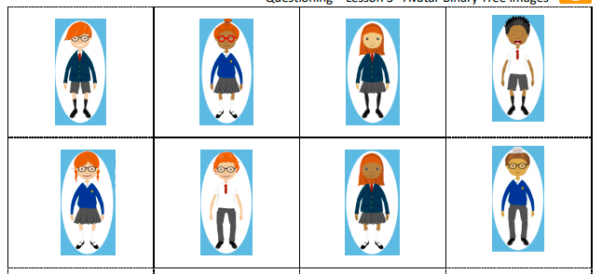
Activity 1: Creating Your Own Binary Tree
Slide 5
Create your own binary tree using one of the sets of pictures.
Need more support? Contact us:
Tel: +44(0)208 203 1781 | Email: support@2simple.com | Twitter: @2simplesoftware
Notes:
Display slide 5. The children should complete their own binary tree using the avatars or animals and the outline sheet.

Slide 6
Activity 2: Extension – Binary Tree
Slide 6
Create your own binary tree using the other set of pictures.
Need more support? Contact us:
Tel: +44(0)208 203 1781 | Email: support@2simple.com | Twitter: @2simplesoftware
Notes:
Display slide 6. Recap the learning from Activity 1. What went well and what could be improved? Use the other set of images to create another binary tree.

Slide 7
Review Success Criteria
Slide 7
I understand what is meant by a binary tree.
I have designed a binary tree to sort pictures of children or animals.
Need more support? Contact us:
Tel: +44(0)208 203 1781 | Email: support@2simple.com | Twitter: @2simplesoftware
Notes:
Review the success criteria from slide 3. Pupils could rate how well they achieved this using a show of hands.

