Slide 1
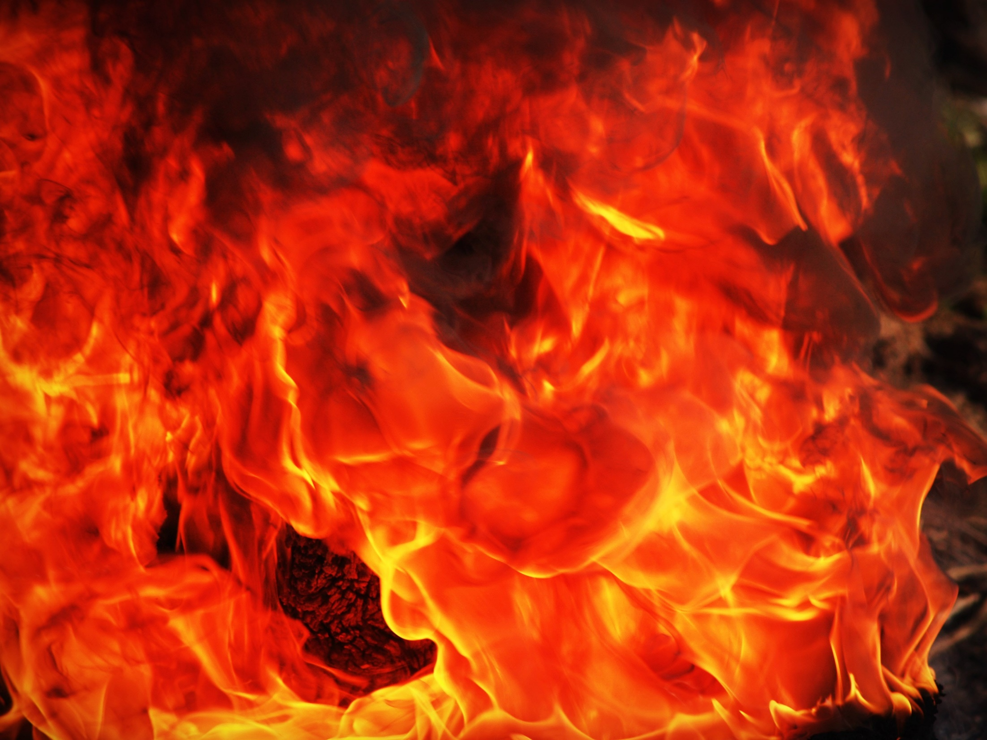
LONDON
HISTORY
Great Fire of London
MATHS
1.Place value
2.Addition and subtraction including column method
3.Money Maths
4.Multiplication and Division
5.Fractions
ENGLISH
Vlad and the GFOL- text working on a recount of the GFOL
Different types of Sentences
Increasing our range of punctuation
Katie in London –text working on a brochure of London Landmarks.
Using adjectives to write expanded noun phrases
Poetry – Hamilton unit working on writing their own poems.
SCIENCE
Materials
Squash, bend , twist ,stretch
LONDON
‘Then and now’
GEOGRAPHY
Compass points
Continents/Capital cities
Rivers, Seas and Oceans.
ART
Sparks and Flames

