Slide 1

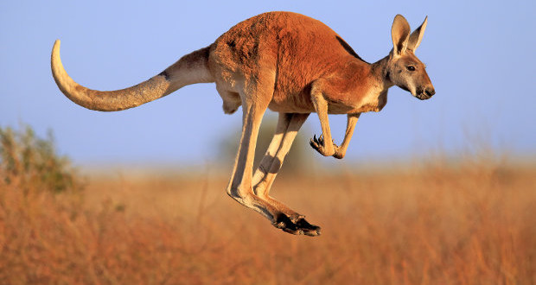
DOWN UNDER
ENGLISH:
Wombat goes Walkabout by Michael Morpurgo.
Retelling the story.
Letter writing
Creating a fact file
Dramatisation
SCIENCE:
Plants
Living things and their habitats
ART:
Fathers Day
Aboriginal art
MATHS:
Statistics
Division
Measurement
Consolidation of 4 operations
GEOGRAPHY:
Australia – locating on the globe.
Oceans
Weather in Australia
MUSIC/DT
Making a Didgeridoo that can be used.

