Slide 1
WELCOME TO DOVE CLASS
We are really looking forward to having you in our class in September

Slide 2
Staffing in Dove class.
Mrs Day and Miss Hipkin are the class teachers.
Miss Hipkin will teach on Monday and Tuesday
Mrs Day will teach on Wednesday, Thursday and Friday.
Mrs Bailey and Mrs Lopez will be the Teaching Assistants.

Slide 3
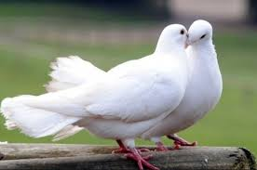
Did you know that Doves have a very symbolic history? We will learn about this when you start in September

Slide 4
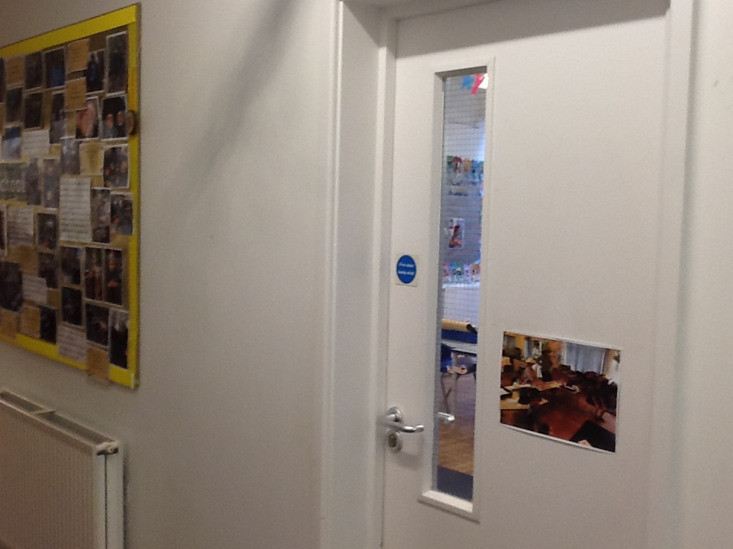
This is the main entrance into the classroom.

Slide 5
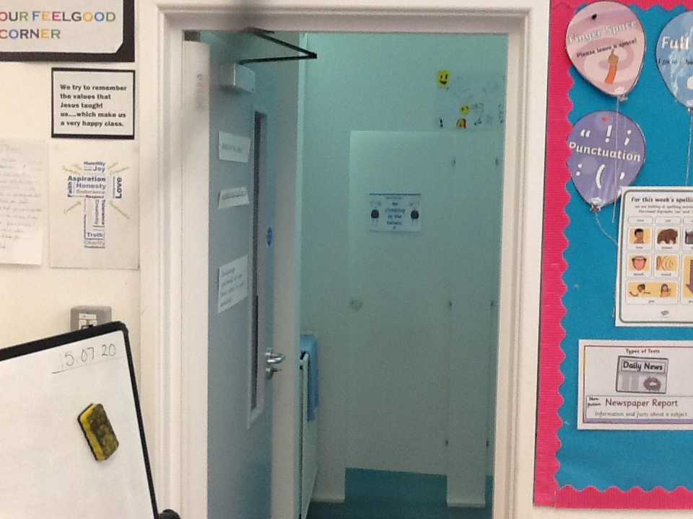
And we have our own grown up loos!!

Slide 6
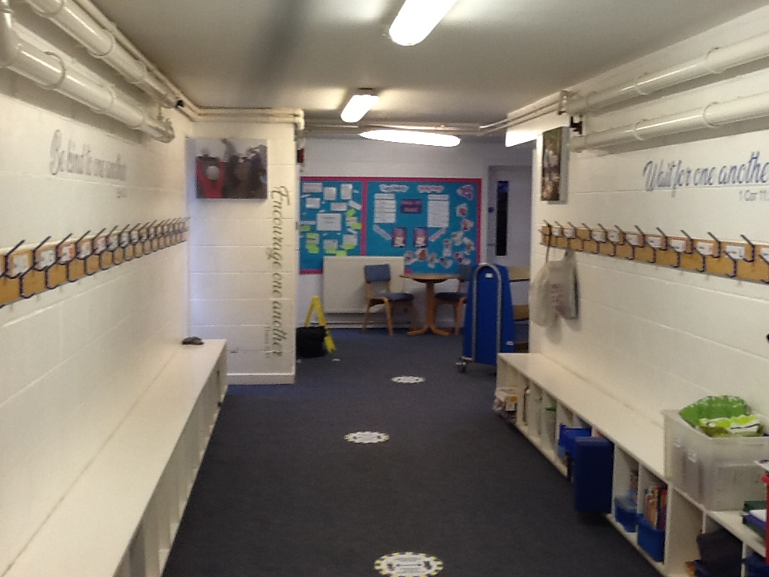
We have a nice, big corridor for our coats and bags…

Slide 7
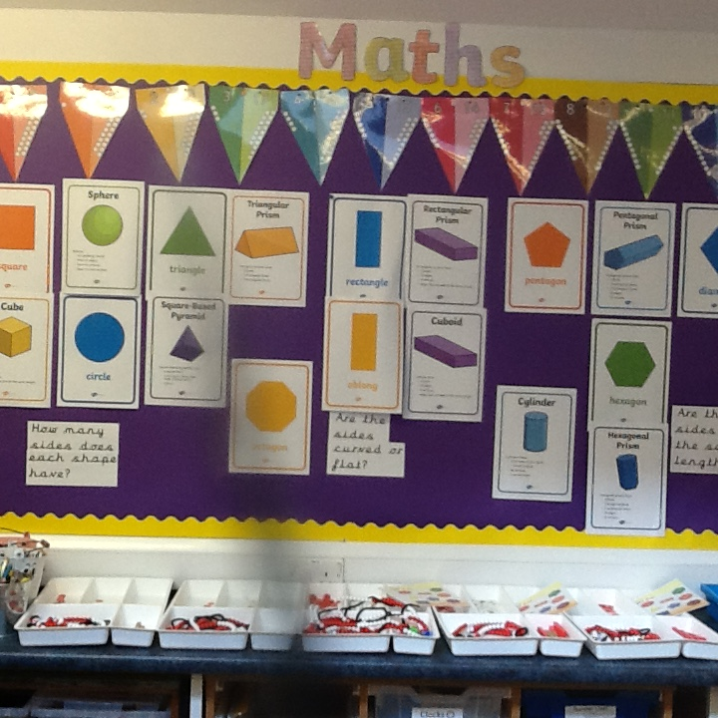
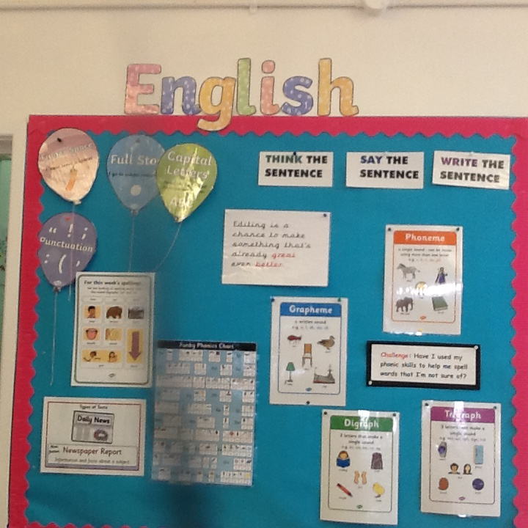
Your new class will have display areas similar to your old Year 1 class.

Slide 8
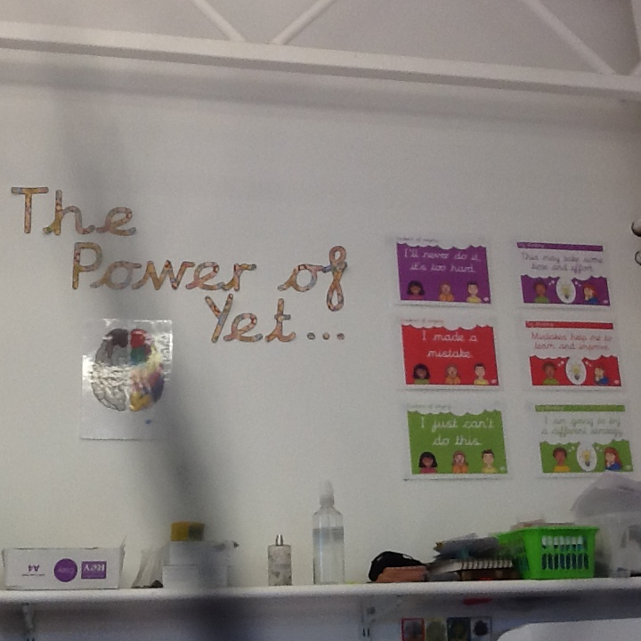
In Dove class we do lots of Growth Mind set – don’t worry if you’re not sure what it means , we will learn all about it in Year 2.

Slide 9
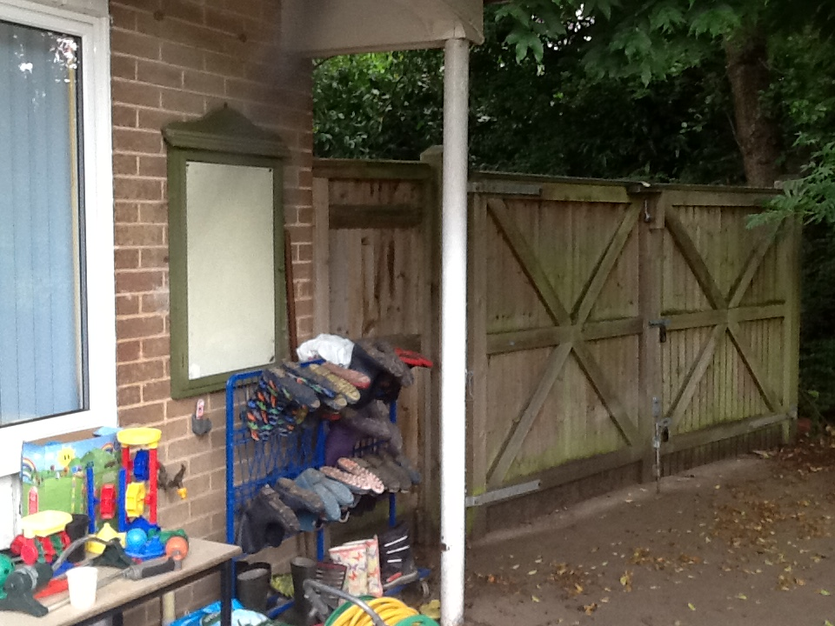
This is the other door to our classroom where your parents and /or carers will pick you up at the end of the day. It is also where we keep our wellies for Forest school.

Slide 10
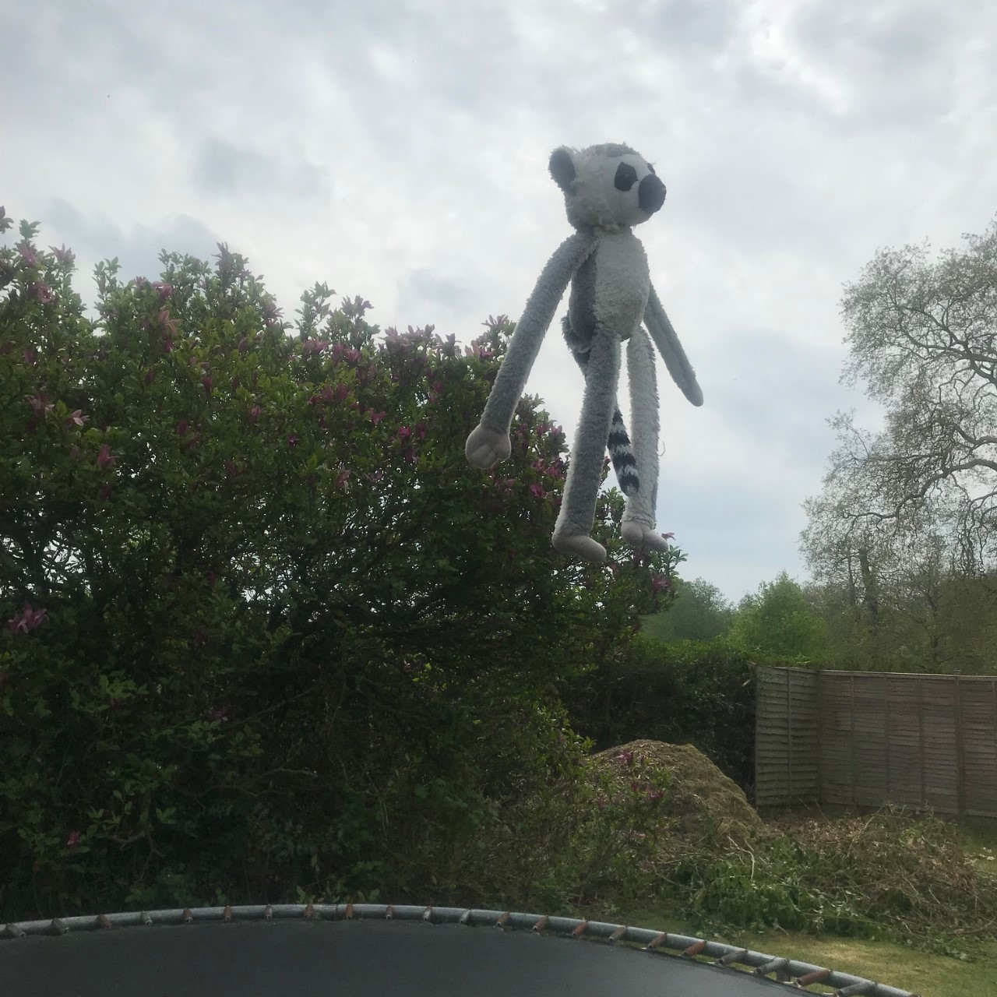
Last, but not least, EVOD - our class cuddly is so excited you will be joining our class. This is Evod jumping on the trampoline in excitement!!!

